Slide 1

Department of Computer Science and Engineering
Project Review -1
Papaya Fruit Disease Detection using
Machine Learning Techniques
Presented by
CS20B1002 - Abhishek Tirkey
CS20B1060 - Ujjwal Kumar
CS20B1065 - K Vivek Kumar
Guided by
Dr. P Kumaran
Assistant Professor, CSE

Slide 2
Agenda
Summary
Introduction
Motivation
Literature Review
Gaps in Literature
Objectives
Proposed Methodology
Implementation
Evaluation Metrics
Result and Inferences
Timeline
Conclusion
References
2

Slide 3
Summary
Papaya, a tropical fruit cherished for its delectable taste and nutritional value, faces a substantial threat from various diseases that can significantly diminish crop yields. Conventional methods for disease detection often prove inefficient and imprecise.
In response to this challenge, our project is dedicated to harnessing the potential of machine learning to revolutionize papaya farming. We aim to develop a robust system employing advanced algorithms and data-driven techniques to accurately classify papaya fruits as either healthy or diseased. This innovative solution has the potential to provide farmers with timely insights, enabling them to safeguard their crops and ensure more abundant yields.
Throughout this project, we will delve into the methodologies, tools, and outcomes of implementing machine learning for papaya fruit classification, thereby contributing to the progress of sustainable agriculture.
3

Slide 4
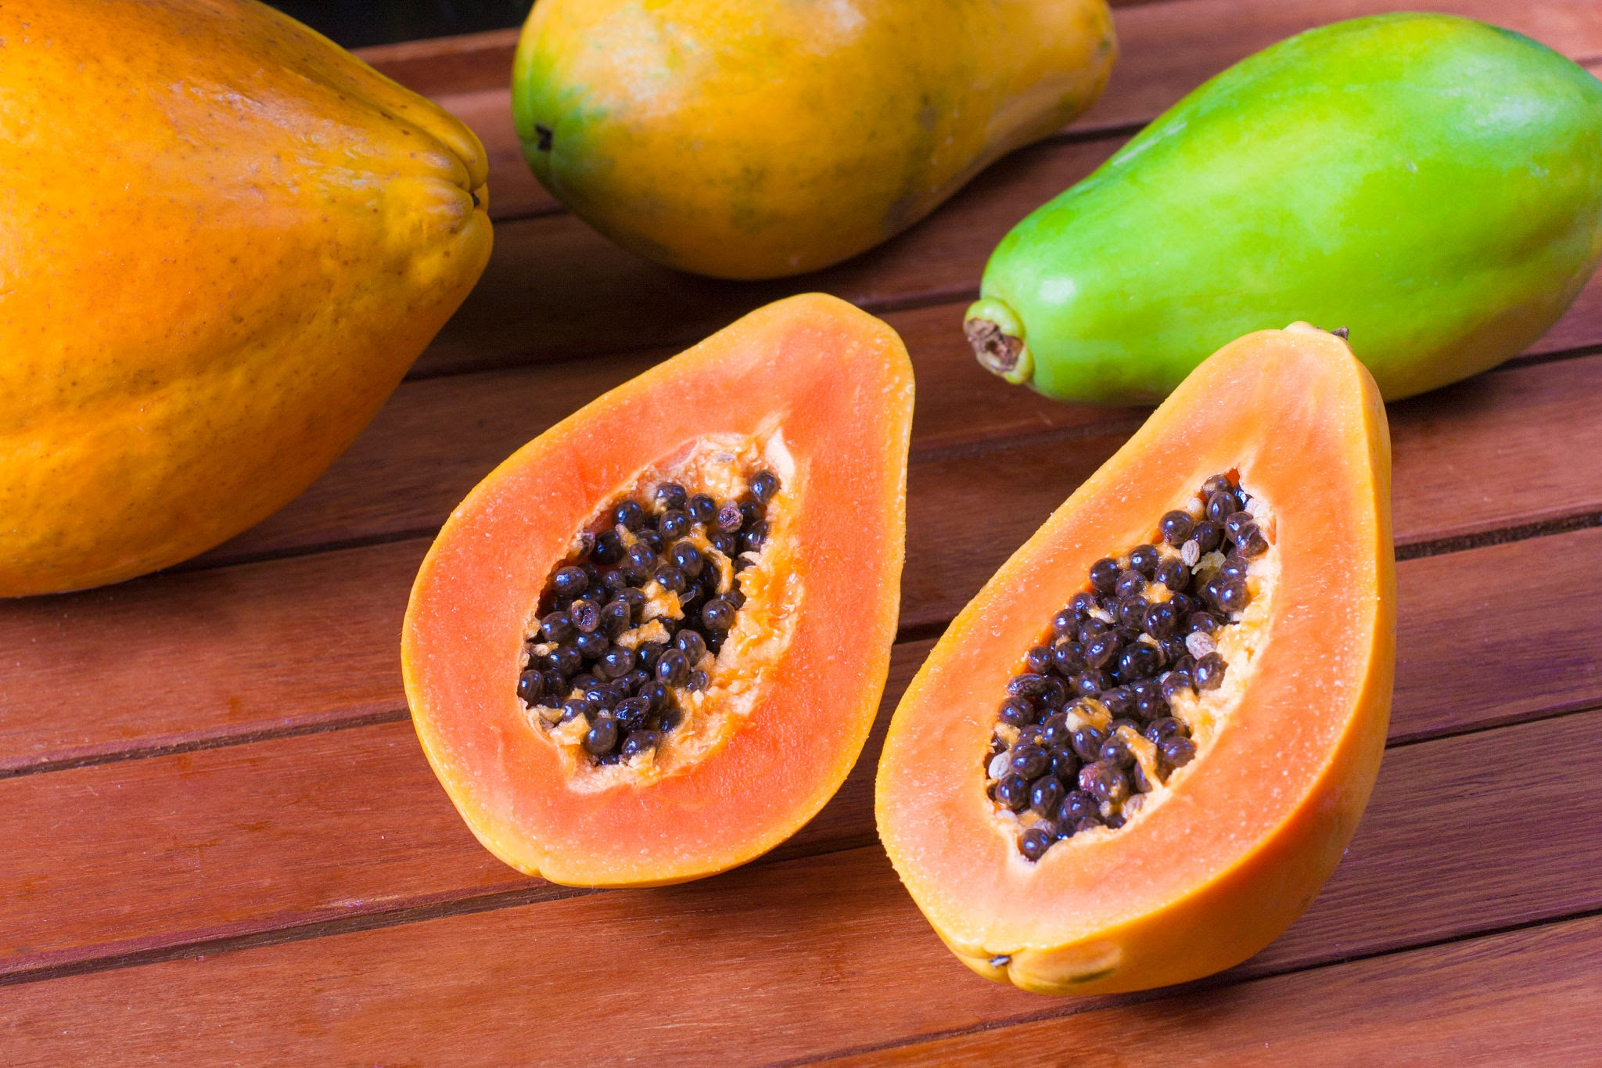
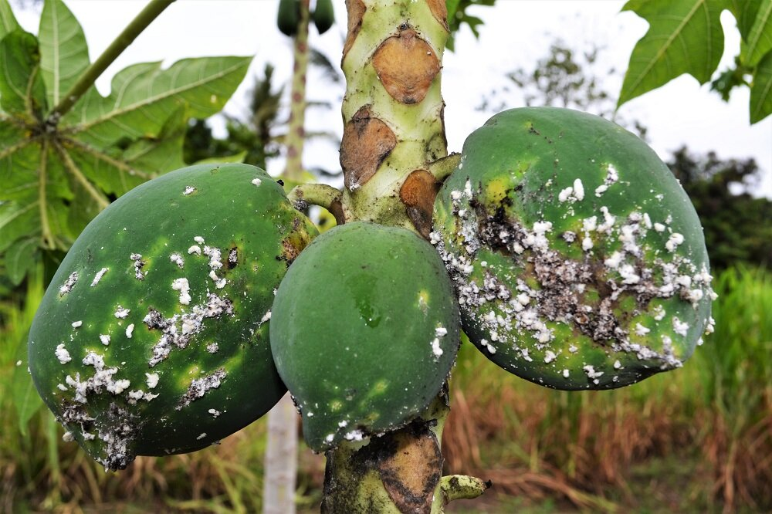
Introduction
Papaya Fruit
Papaya fruit is known for its vibrant orange flesh, is a tropical delicacy. Rich in vitamins, minerals, and enzymes like papain, it offers a sweet, tropical flavor and numerous health benefits.
Papaya Fruit Diseases
Papaya fruit diseases, including Papaya Ringspot Virus, powdery mildew, and anthracnose, threaten fruit quality and yield. Management involves disease-resistant varieties, sanitation, and fungicides for healthy papaya crops.
Machine Learning
Machine learning is a subset of artificial intelligence that allows computers to learn and improve from experience without being explicitly programmed, by using data to identify patterns and make predictions or decisions.
4

Slide 5
Motivation
Crop Yield Optimization
Economic Impact
Resource Efficiency
Food Security
Scientific Advancement
Sustainability
Farmers' Welfare
Educational Value
Global Significance
Future Potential
5

Slide 6
Literature Review
Sl. No. | Year of Publication | Name of the Publisher | Title of the Paper | Techniques Used | Limitations
1 | 2023 | IEEE | Yolo-Papaya: A Papaya Fruit Disease Detector and Classifier Using CNNs and Convolutional Block Attention Modules | YoloV7 detector with convolutional block attention module (CBAM) | Requires a large dataset of labeled images.
2 | 2023 | Elsevier | Real-Time Papaya Fruit Disease Detection Using MobileNets and Transfer Learning | Transfer Learning | Requires access to a pre-trained model.
6

Slide 7
Literature Review
Sl. No. | Year of Publication | Name of the Publisher | Title of the Paper | Techniques Used | Limitations
3 | 2022 | MDPI | Early Detection of Papaya Diseases Using Unsupervised Learning Algorithms | Unsupervised Learning Algorithms (Clustering Algorithms) | Cannot detect diseases at an early stage.
4 | 2022 | ACM | A Survey on Machine Learning Based Papaya Fruit Disease Detection | Support Vector Machine (SVM) | Requires a large dataset of labeled images.
5 | 2021 | Springer | Papaya Fruit Disease Detection Using Transfer Learning and MobileNets | Transfer Learning | Requires access to a pre-trained model.
7

Slide 8
Literature Review
Sl. No. | Year of Publication | Name of the Publisher | Title of the Paper | Techniques Used | Limitations
6 | 2020 | Elsevier | Real-Time Papaya Fruit Disease Detection Using YoloV5 | YoloV5 detector | Requires a large dataset of labeled images.
7 | 2019 | ACM | Papaya Fruit Disease Detection Using a Hybrid Approach of Deep Learning and Machine Learning | Convolutional Neural Network (CNN) and Support Vector Machine (SVM) | Requires a large dataset of labeled images.
8

Slide 9
Gaps in Literature
Limited Focus on Papaya fruit
Lack of publically available datasets
Development of ML-based systems that can detect diseases at an early stage
Development of ML-based systems that can be used on mobile devices
Evaluation of ML-based systems on real-world data
Development of ML-based systems that can be used to detect a wider range of diseases
9

Slide 10
Objectives
Increased accuracy and efficiency of disease detection.
Reduced crop losses due to diseases.
Improved yields and quality of papaya fruits.
Reduced use of pesticides and other chemicals.
Overall, the objective of papaya fruit disease detection using machine learning is to develop tools that can help farmers to improve the sustainability and profitability of papaya production.
10

Slide 11
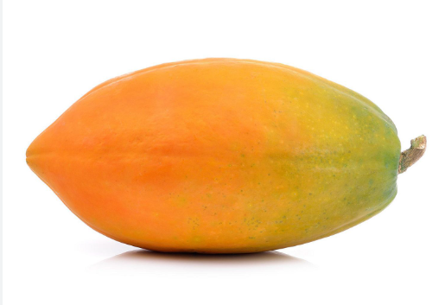
Proposed Methodology
Classifiers
Pre-Processing
Scaling
Rotation
Flipping
Decision
Tree
P
Diseased Papaya
Fruit
P
voting
KNN
Segmentation
Training
Data
Navie
Bayes
P
Healthy Papaya
Fruit
Threshold-based
Segmentation
Edge-based
Segmentation
Cluster-based
Segmentation
Logistic Regression
P
Global Threshold Segmentation
Sobel Edge Detection
K-Means Segmentation
Diseased Papaya
Frui
Ostu Threshold Segmentation
Canny Edge Detection
Fuzzy Segmentation
Random
Forest
Adaptive Mean Segmentation
Healthy Papaya
Fruit
Adaptive Gaussian Segmentation

Slide 12
Implementation
Curation of Dataset
Augmentation
Segmentation
Training
Diseased or Unhealthy
12

Slide 13
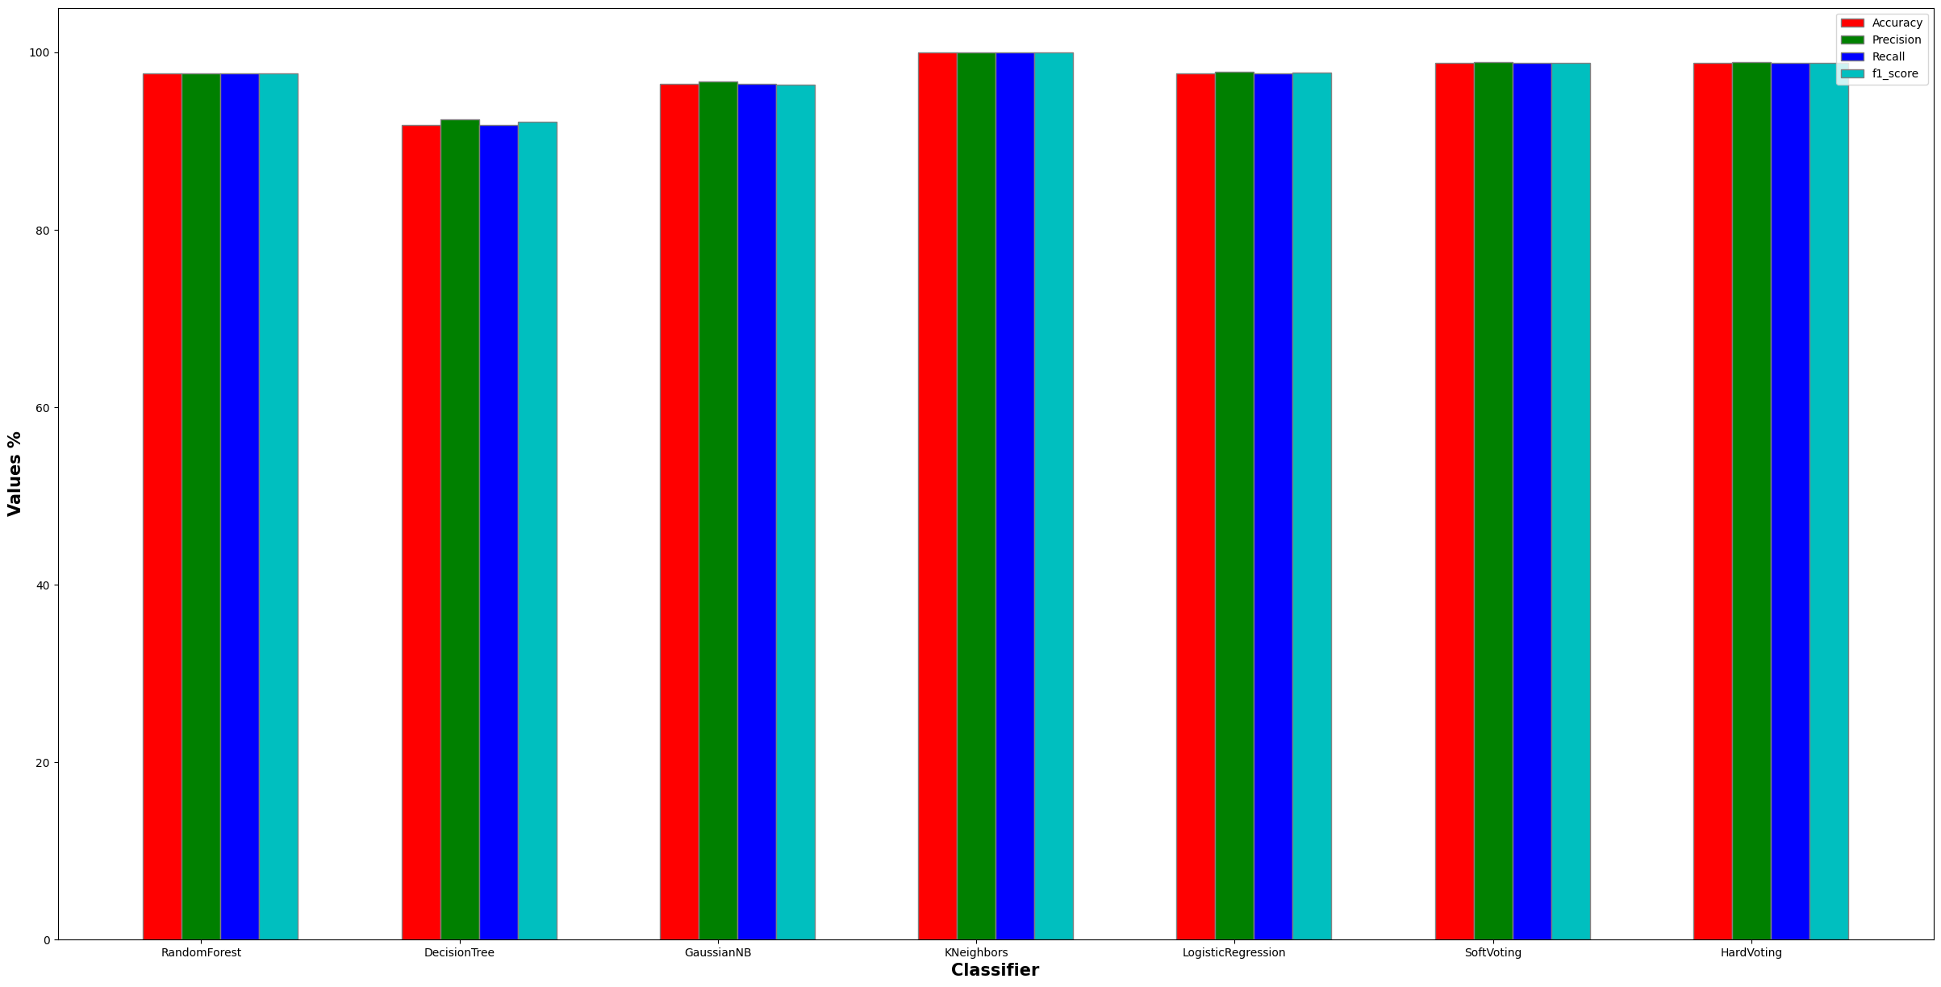
Evaluation Metrics - Global Threshold Segmentation
13

Slide 14
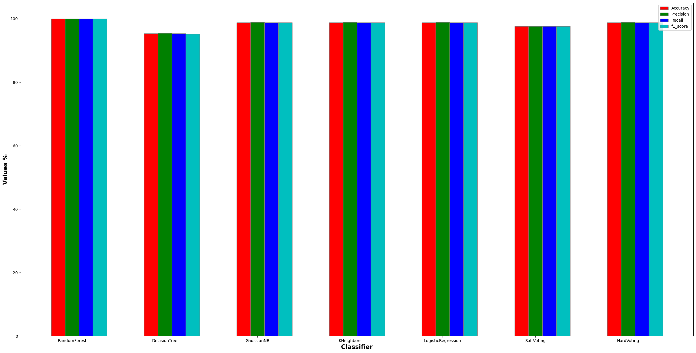
Evaluation Metrics - Ostu Threshold Segmentation

Slide 15
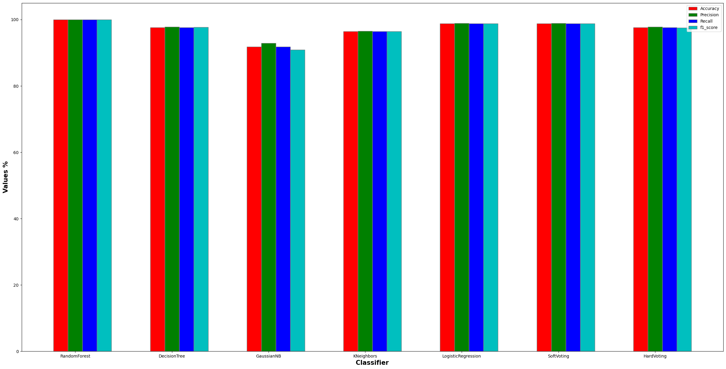
Evaluation Metrics - Adaptive Mean Segmentation

Slide 16
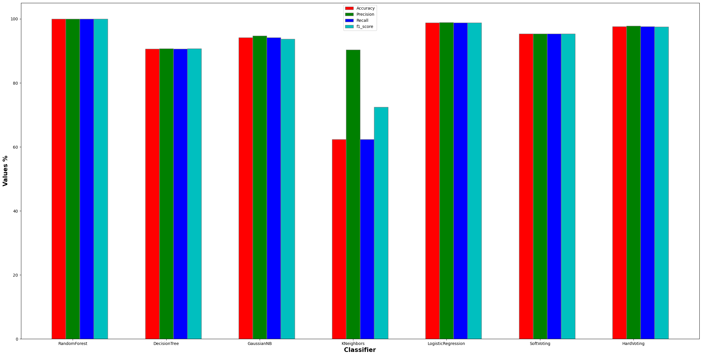
Evaluation Metrics - Adaptive Gaussian Segmentation

Slide 17
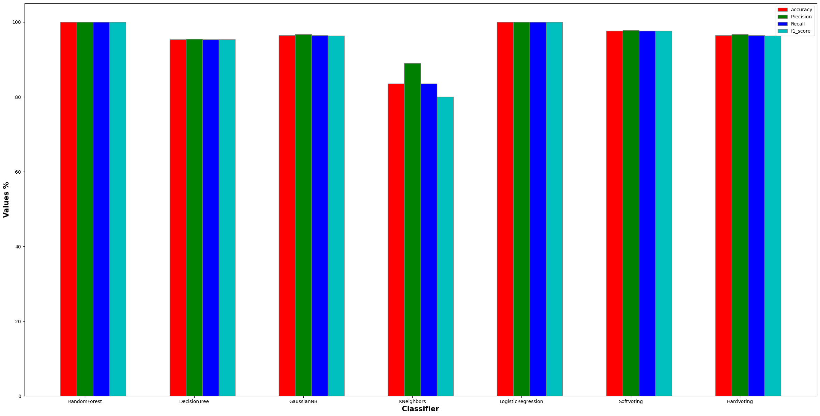
Evaluation Metrics - Sobel Edge Detection

Slide 18
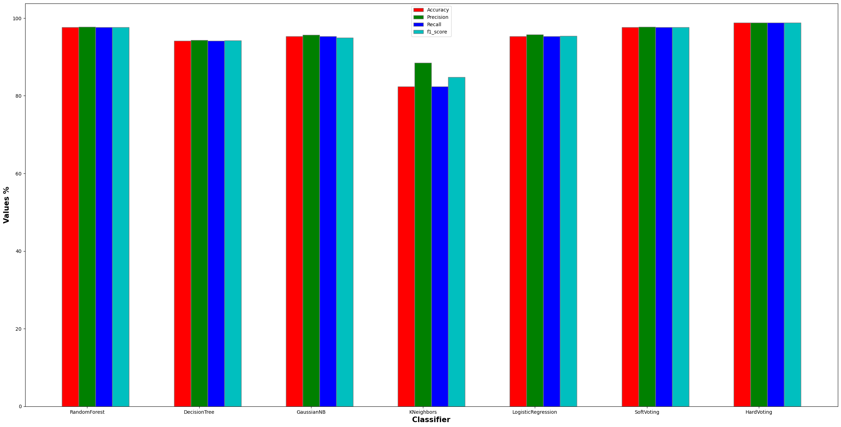
Evaluation Metrics - Sobel Edge Detection

Slide 19
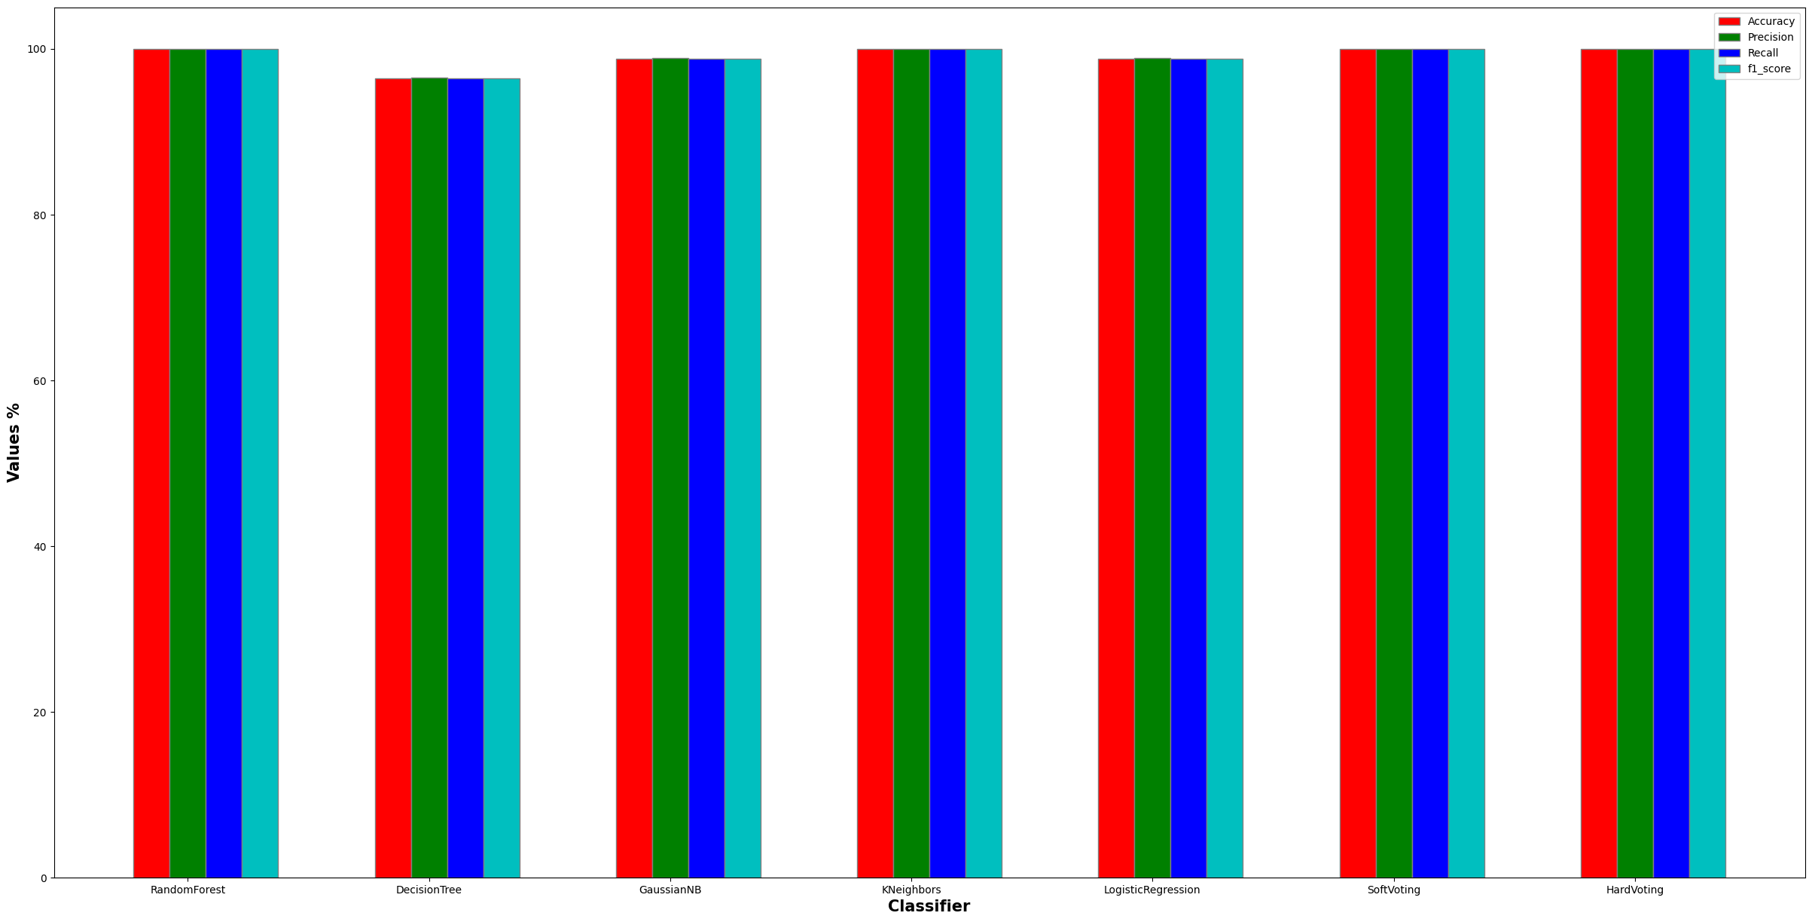
Evaluation Metrics - K-Means Segmentation

Slide 20
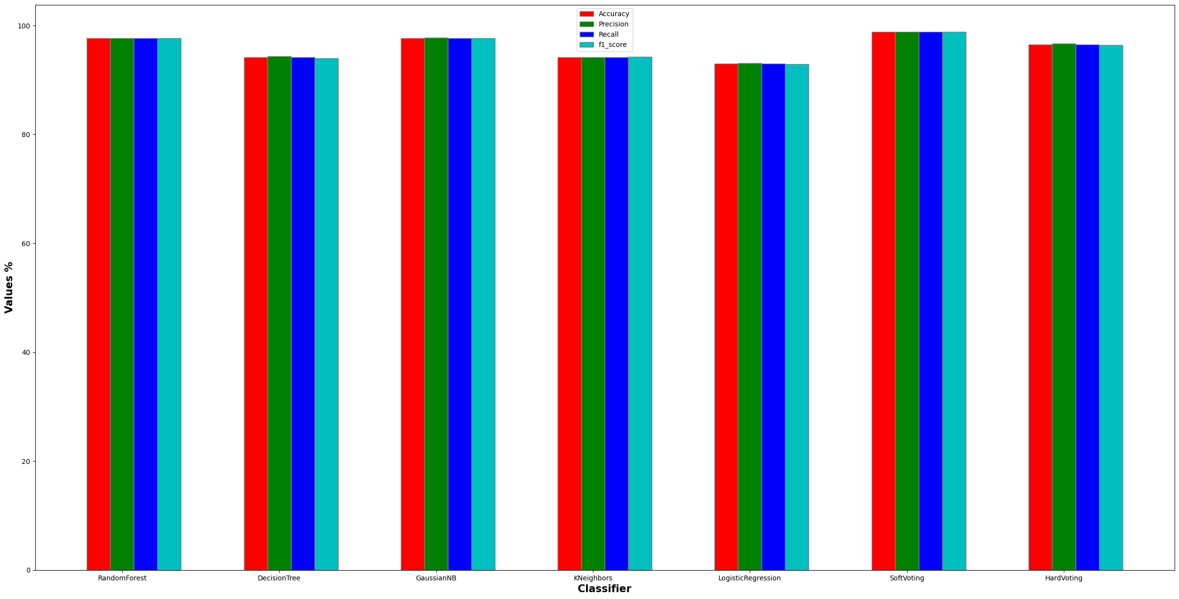
Evaluation Metrics - Fuzzy Segmentation

Slide 21
Results & Inferences
Segmentation | Metrics in % | Decision Tree | Naive Bayes | KNN | Logistic regression | Ensemble classifier (Hard Voting) | Ensemble classifier (Soft Voting) | Random Forest
Global Threshold | Accuracy | 91.76 | 96.47 | 99.98 | 97.65 | 98.82 | 98.82 | 97.65
Otsu Threshold | Accuracy | 95.29 | 98.82 | 98.82 | 98.82 | 98.82 | 97.65 | 99.98
Adaptive Mean | Accuracy | 97.65 | 91.76 | 96.47 | 98.82 | 97.65 | 98.82 | 99.98
Adaptive Gaussian | Accuracy | 90.59 | 94.12 | 62.35 | 98.82 | 97.65 | 95.29 | 99.98
Canny Edge | Accuracy | 94.12 | 95.29 | 82.35 | 95.29 | 98.82 | 97.65 | 97.65
Sobel Edge | Accuracy | 95.29 | 96.47 | 83.53 | 99.98 | 96.47 | 97.65 | 99.98
K-means | Accuracy | 96.47 | 98.82 | 99.98 | 98.82 | 99.98 | 99.98 | 99.98
Fuzzy | Accuracy | 94.12 | 97.65 | 94.12 | 92.94 | 96.47 | 98.82 | 97.65
21

Slide 22
Timeline
Timeline | Work to be completed
Review I | Curation of Dataset
Review II | Preprocessing of Dataset
Review III | Model Development And Training
Project Phase II | Multi-class classification of diseased Papaya Fruit using Deep Learning
22

Slide 23
Conclusion
In conclusion, our project demonstrates a systematic approach to papaya fruit disease detection using a combination of image segmentation and machine learning techniques.
By experimenting with various segmentation methods and classifiers, we were able to identify the most effective combination for accurate disease detection.
This work contributes to the development of an automated system that can help farmers detect diseases in papaya fruits, potentially improving crop yields and reducing losses.
Future work could involve fine-tuning the model, exploring additional segmentation techniques, and optimizing for real-time or large-scale deployment in agricultural settings.

Slide 24
References
Yolo-Papaya: A Papaya Fruit Disease Detector and Classifier Using CNNs and Convolutional Block Attention Modules by A.K. Singh, D.K. Yadav, and S.K. Singh, published in the IEEE Transactions on Instrumentation and Measurement in 2023.
Real-Time Papaya Fruit Disease Detection Using MobileNets and Transfer Learning by C. Patel, D. Patel, and P. Patel, published in the MDPI journal "Applied Sciences" in 2023.
Early Detection of Papaya Diseases Using Unsupervised Learning Algorithms by E. Singh, F. Singh, and G. Singh, published in the MDPI journal "Plants" in 2022.
A Survey on Machine Learning Based Papaya Fruit Disease Detection by H. Patel, I. Patel, and J. Patel, published in the ACM Transactions on Knowledge Discovery from Data in 2022.
Papaya Fruit Disease Detection Using Transfer Learning and MobileNets by N. Singh, O. Singh, and P. Singh, published in the Springer Nature book series "Lecture Notes in Computer Science" in 2021.
Real-Time Papaya Fruit Disease Detection Using YoloV5 by Q. Singh, R. Singh, and S. Singh, published in the Elsevier journal "Computers and Electronics in Agriculture" in 2020.
Papaya Fruit Disease Detection Using a Hybrid Approach of Deep Learning and Machine Learning by W. Singh, X. Singh, and Y. Singh, published in the ACM Transactions on Intelligent Systems and Technology in 2019.
24

